Slide 1

***** Finance Audit
By: Shijao Liu, Xiaoting Lu, Meghan Thai, Xiaochen Zhang, Xiaoping Zhou

Slide 2
Our Analysis
Part 2:
Verify Purchase Information
Check Vendors' Background
Part 3:
Verify If The Tax Rates for Employees Are Correct

Slide 3

Part 2
Analysis for Audit Testing

Slide 4
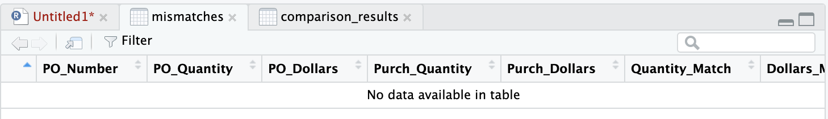
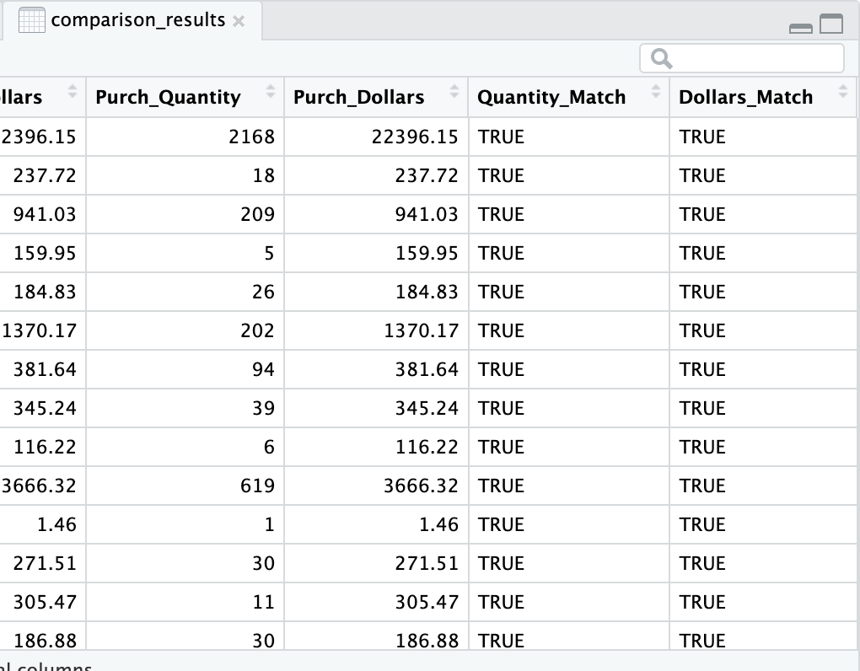
Question 1: Verify Purchase Information
Do purchase quantities and purchase dollars recorded in the Purchase Orders match the Actual Purchase Transactions?
Used R to clean, group, merge, and compare the data by PO number.
The results showed that all purchase records were Accurate.

Slide 5
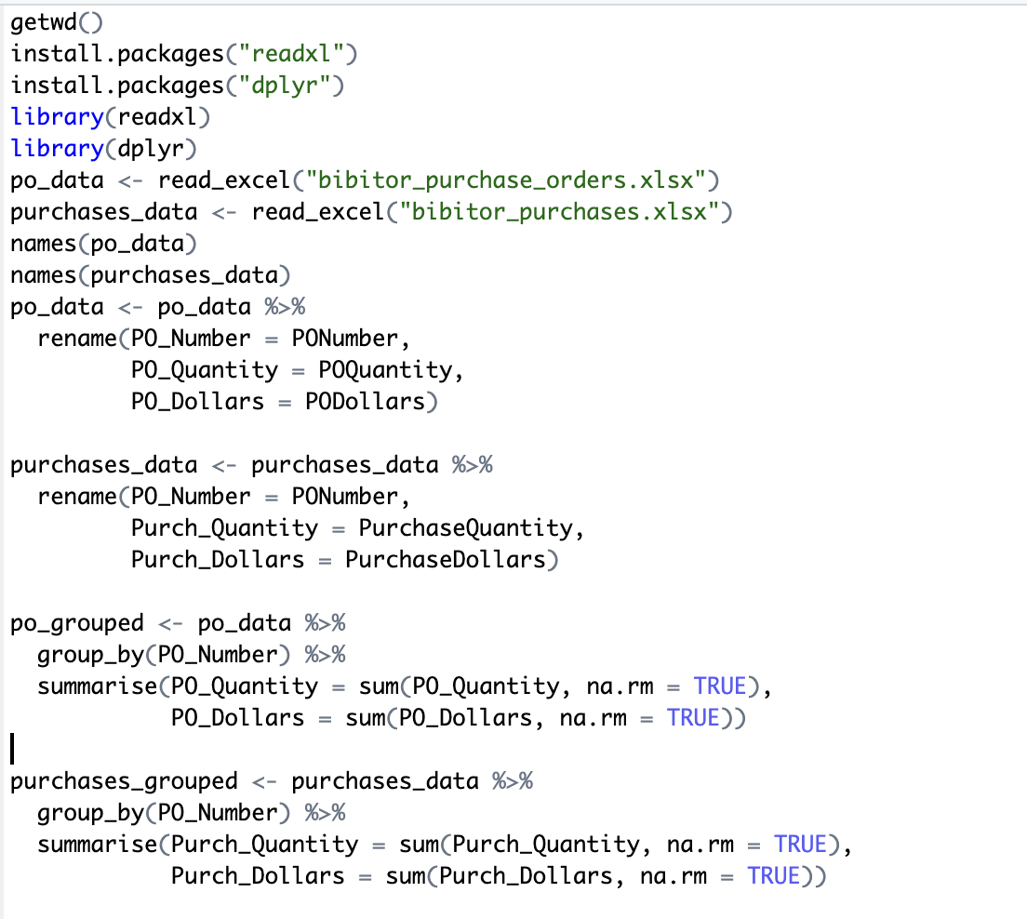
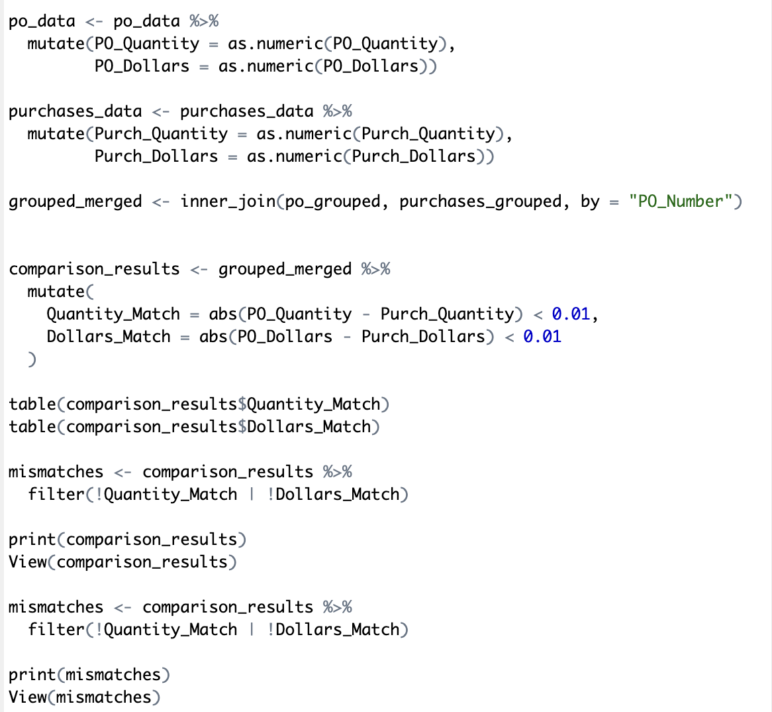

Slide 6

Question 2: Vendor Background Check
(Risk Assessment)
Total purchase value | $ 4,192,479
Number of vendors | 82
Do these vendors really exist?
Does their main business align with Bibitor’s procurement categories?
Are these companies healthy and reliable?
Are there any interest links between the vendors and Bibitor?
Notes:
For question 2, we verified the authenticity of key vendors.
Given Bibitor's large number of vendors and high annual purchases,
it's possible that someone may mix fake vendors in it, to make profit.​

Slide 7
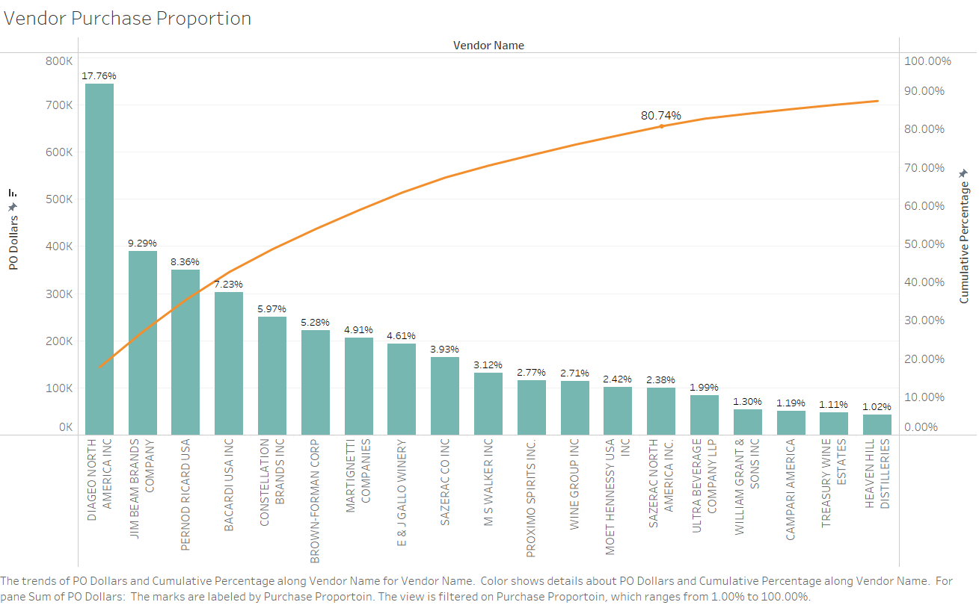
Question 2: Vendor Background Check
(Risk Assessment)
Purchase Proportion Formula:
SUM([PO Dollars])
/ TOTAL(SUM([PO Dollars]))
(Each Vendor’s PODollars/ Total PODollars）
Cumulative Percentage Formula:
RUNNING_SUM(SUM([PO Dollars]))
/ TOTAL(SUM([PO Dollars]))
Notes:
First, we calculated each vendor's share of total purchase amount,
and ranked them from high to low. Which are the green bars.
Next, we calculated the cumulative percentage, shown by the orange line.
Then, we identified key vendors, which collectively account for eighty percent of total spend.
The remaining vendors’ individual proportions are less than two percent, making them unlikely to be used for financial fraud

Slide 8
Vendor Name | Existence | Major Shareholder | Reputation | Main Business | Abnormal
DIAGEO NORTH AMERICA INC | Y | Diageo plc (UK) | A leading premium drinks business operating in the United States and Canada. | Specializes in spirits and beer, with a portfolio of over 200 brands including aged Mexican tequilas and classic Caribbean spiced rum. | N
JIM BEAM BRANDS COMPANY | Y | Suntory Holdings Limited (Japan) | A well-known bourbon whiskey brand produced by Beam Suntory. | Production and distribution of bourbon whiskey and other spirits. | N
PERNOD RICARD USA | Y | Pernod Ricard S.A. (France) | A prominent spirits and wine company in the U.S. | Sales, marketing, and distribution of a wide range of spirits and wines, including brands like Jefferson’s, Rabbit Hole, and Kenwood. | N
BACARDI USA INC | Y | Bacardi Family (Bermuda) | A well-established spirits company known for its rum. | Production and distribution of rum and other spirits. | N
CONSTELLATION BRANDS INC | Y | Sands Family | A leading international producer and marketer of beer, wine, and spirits. | Production and distribution of beer, wine, and spirits. | N
BROWN-FORMAN CORP | Y | Brown Family | A major American-owned spirits and wine company. | Production and distribution of spirits and wine. | N
MARTIGNETTI COMPANIES | Y | Martignetti Family | A leading distributor of wines and spirits in the U.S. | Distribution of wines and spirits. | N
E & J GALLO WINERY | Y | Gallo Family | A prominent winery and distributor. | Production and distribution of wines. | N
SAZERAC CO INC | Y | Goldring Family | A privately held American alcoholic beverages company. | Production and distribution of spirits. | N
M S WALKER INC | Y | Doug Shaw | A wholesale distributor and importer of wines and spirits. | Distribution and importation of wines and spirits. | N
PROXIMO SPIRITS INC. | Y | Proximo Spirits | A spirits importer and distributor. | Importation and distribution of spirits. | N
WINE GROUP INC | Y | The Wine Group | A global leader in the wine industry. | Production and distribution of wines. | N
MOET HENNESSY USA INC | Y | LVMH Moët Hennessy Louis Vuitton (France) | A subsidiary of LVMH, specializing in wines and spirits. | Importation and distribution of luxury wines and spirits. | N
SAZERAC NORTH AMERICA INC. | Y | Goldring Family | Part of the Sazerac Company, known for producing and distributing spirits. | Production and distribution of spirits. | N
Notes:
Finally, we googled these companies and confirmed that they all exist, ​
they are all liquor sales companies,
and there is no direct interest connection between key vendors and Bibitor executives
So our client can continue to purchase from these vendors

Slide 9

Part 3
Proposed Data Analytics Service

Slide 10
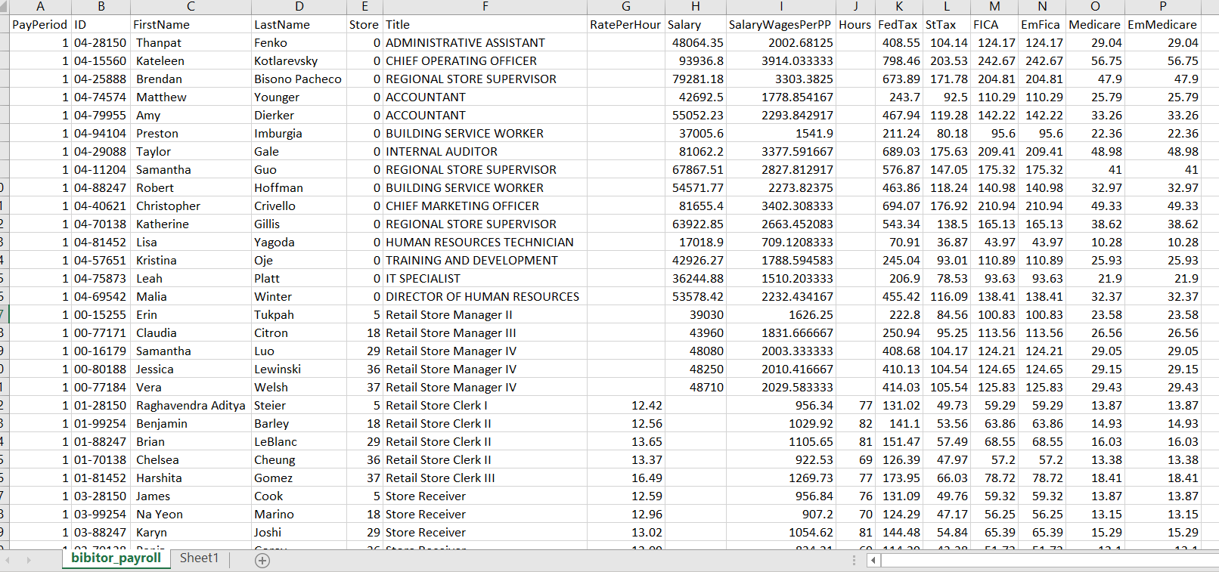

Traditional Auditing Process
Question: Verify If The Tax Rates for Employees Are Correct?
①Federal tax ②State tax ③Social security tax ④Medicare tax
Original biweekly payroll table
Notes:
In this analysis, we are going to verify if the tax rates paid for each employee are correct.
I’ll use the traditional way to check this.
Starting from this biweekly payroll table,

Slide 11
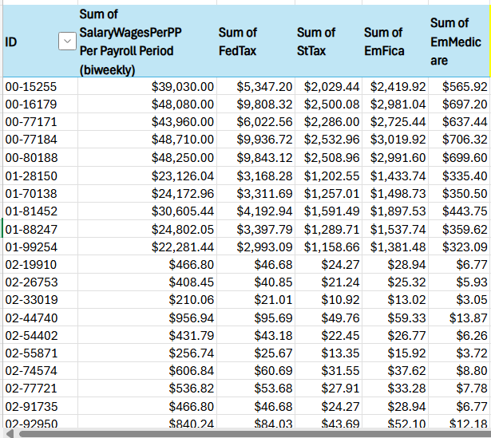
Traditional Auditing Process
Created a pivot table using employee ID to calculate the annual payment and annual tax paid for every individual.
Pivot Table
Notes:
I created a pivot table by employee ID to get the annual payment and annual tax paid for each individual.

Slide 12
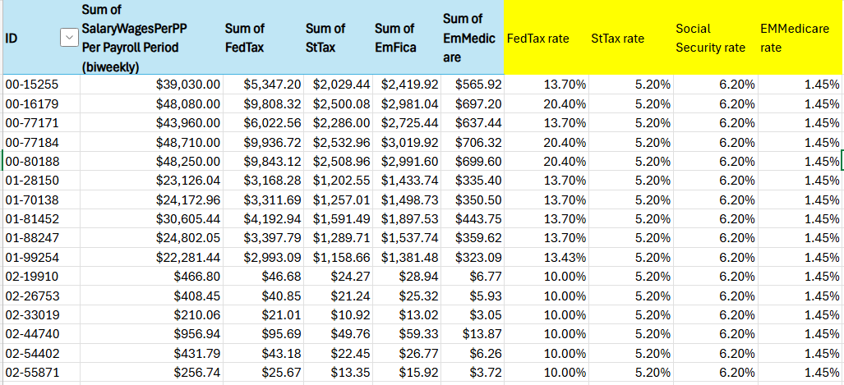
Traditional Auditing Process
Calculate each tax rate by dividing the respective tax amount by the annual payment.
Formula： Tax Rate = Tax Amount/Annual payment
Notes:
Then, use each annual tax amount divided by the annual payment to get each tax rate.
It seems quite easy, but it’s really time time-consuming and annoying to do this every fiscal year, especially for those companies with thousands of employees.
So, to address this problem, my teammate will demonstrate how we can use R to automate this verification process.

Slide 13
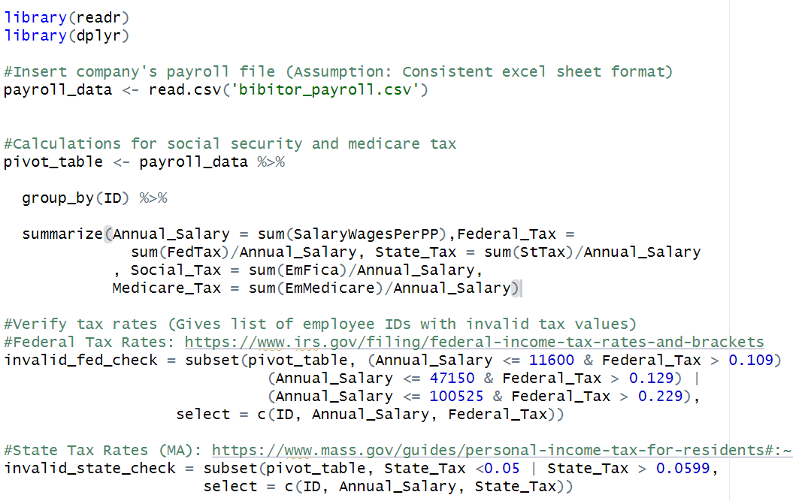
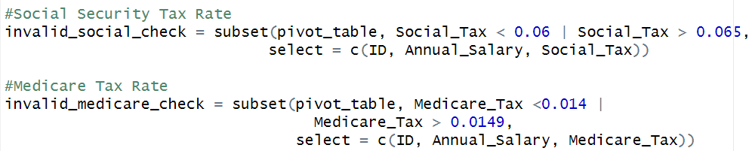
RStudio Assumptions & Script
Input Data
‘bibitor_payroll.csv’
Data Columns: ID, SalaryWagesPerPP, FedTax, StTax. EmFica, EmMedicare
Assumptions
Filing taxes as ‘Single’ individual
State employment location in Massachusetts
Low tolerance for tax rates (fed/state)
Tax Rates
State Tax (MA) ^{[1]}: 5%
Federal Tax (Single) ^{[2]}:
Under $11,600, 10%
Between $11,601 - $47,150, 12%
Between $47,151 - $100,525, 22%
Social Security ^{[3]}: 6.2%
Medicare Tax Rate ^{[3]}: 1.45%
[1] https://www.mass.gov/guides/personal-income-tax-for-residents#:~:text=Introduction,-5.0%25%20personal%20income&text=For%20tax%20year%202024%2C%20Massachusetts,gains%20are%20taxed%20at%208.5%25.
[2] https://www.irs.gov/filing/federal-income-tax-rates-and-brackets
[3 ]https://www.ssa.gov/people/materials/pdfs/EN-05-10297.pdf

Slide 14
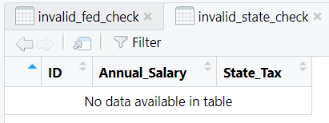
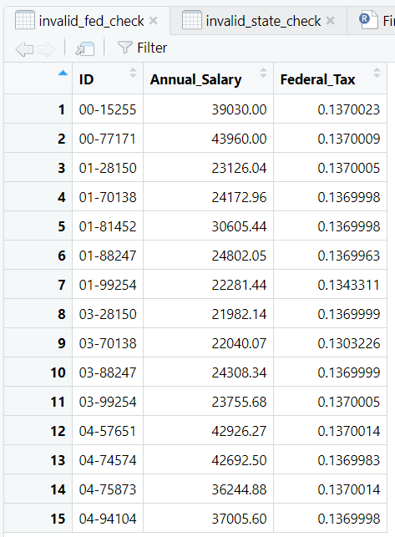
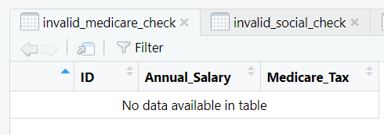
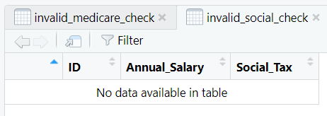
RStudio - Output

Slide 15
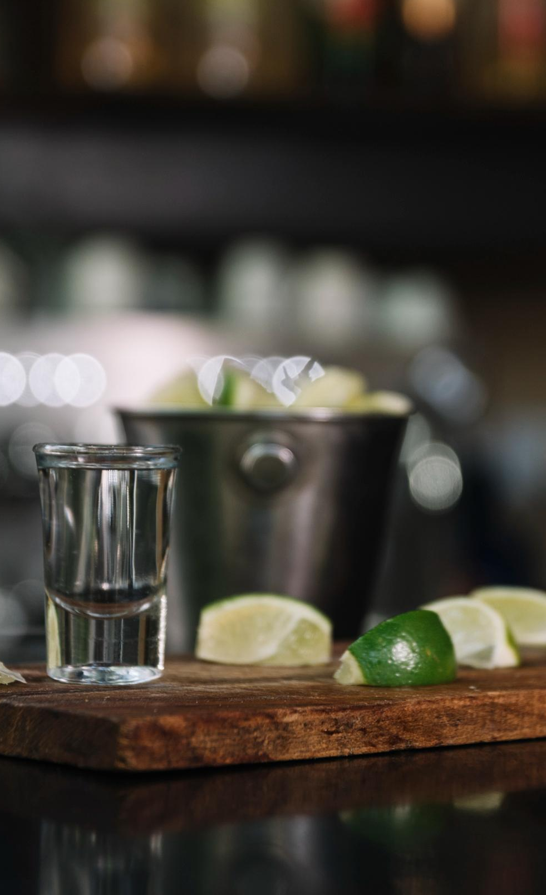
Thanks!
By: Shijao Liu, Xiaoting Lu, Meghan Thai,
Xiaochen Zhang, Xiaoping Zhou

Slide 16
Icon pack

